Slide 1







SECURITY CODING REVIEW
Code Alpha Cyber Security Intern
By Om Mehra

Slide 2
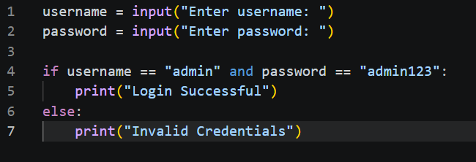

APPLICATION REVIEWED
Application Name:
Python Login System
Programming Language:
Python
Purpose:
Authenticate users using a username and password.

Slide 3

VULNERABILITY 1: HARDCODED CREDENTIALS
The username and password are directly written inside the source code.
Example:
username = "admin"
password = "admin123"
Risk:
Anyone with access to the code can view the credentials.

Slide 4

VULNERABILITY 2: PLAINTEXT PASSWORDS
Passwords are stored in plain text.
Example:
admin123
Risk:
Passwords can be easily exposed if the source code is leaked.

Slide 5


VULNERABILITY 3: NO BRUTE FORCE PROTECTION
The application allows unlimited login attempts.
Risk:
Attackers can repeatedly guess passwords until they gain access.

Slide 6


RECOMMENDATIONS
1. Store passwords securely using hashing.
2. Avoid hardcoded credentials.
3. Implement account lockout after multiple failed attempts.
4. Validate user inputs.
5. Store sensitive data in secure databases.

Slide 7


SECURE CODING EXAMPLE
import hashlib
password = "admin123"
hashed_password = hashlib.sha256(password.encode()).hexdigest()
print(hashed_password)
Hashing protects passwords from being exposed directly.

Slide 8
CONCLUSION
The reviewed application contains multiple security weaknesses.
Applying secure coding practices significantly improves application security and protects user data.

Slide 9
THANK YOU
By Om Mehra

